Slide 1
Discovering event episodes from sequences of online news articles: A time-adjoining frequent itemset-based clustering method
Submitted by:-
Mayur Bhat(181CO132)
Sukruth N Bhat(181CO154)

Slide 2
Review 1-Paper

Slide 3
Why do organizations perform environmental surveillance?
Organizations need to perform environmental surveillance to identify the important events and their developments so that they can incorporate the experience gained by doing that in decision making,strategy formulation and business action. In this paper focus is online news articles.
Online news articles have become an integral part of environmental surveillance because of unprecedented growth of the internet.

Slide 4
How do the companies do it?
Companies use a technique known as Event evolution patterns (EEPs) in order to perform their environmental surveillance.
Companies perform this because EEPs depict the evolution of a particular event type over time which inturn helps them to get prepared for similar kinds of events in the near future.

Slide 5
Structure of an event
There are several different event structures or taxonomies. Some of them are Story→Event→Topic, Story→Simple Event→Complex Event, Story→Component Event→Event, Story→Episode→Event. In this paper, Story→Episode→Event structure has been followed. The next slide explains the concept in detail with an example.

Slide 6
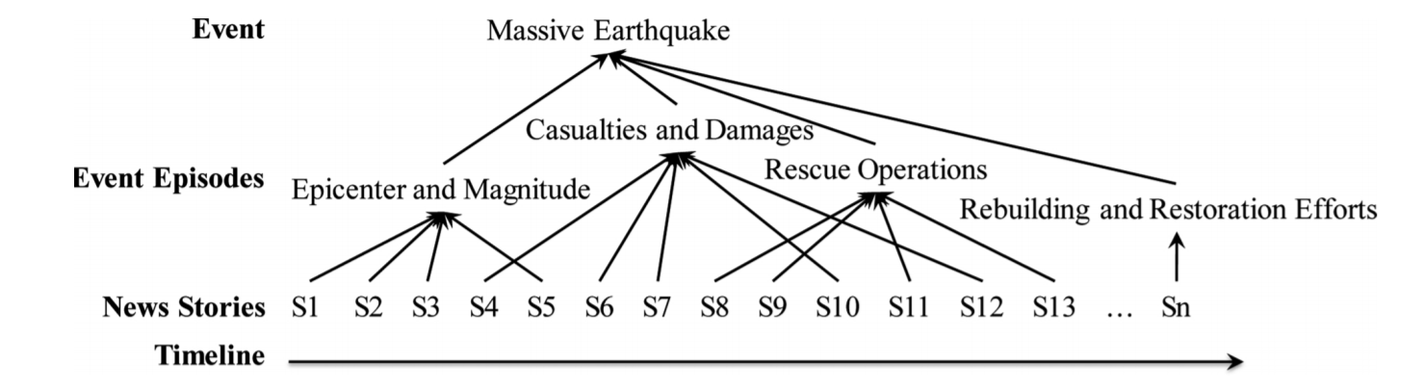
Example explaining an event’s structure

Slide 7
Retrospective event detection and Event episode discovery
A critical precursor to EEP discovery is identifying and grouping articles representing distinct episodes of an event from a sequence of news articles (documents) that pertain to that event.
Retrospective event detection and event episode discovery are two approaches mentioned in this paper for doing the above process.

Slide 8
Retrospective event detection
Retrospective event detection techniques generally discover events from a stream of news articles.
They target an event-based classification by clustering a sequence of chronologically ordered news articles, available in different sources or languages, to identify a set of coherent topics (events) inherent to the news articles.

Slide 9
Event episode discovery
Event episode discovery explicitly aims at discovering an event as it evolves through different development stages and identifying news articles that pertain to each stage.

Slide 10
Which is better?
Event episode discovery identifies distinct episodes of an event from a sequence of news articles related to that event
Retrospective event detection identifies events from a stream of articles by segmenting the different events described by these articles.
As a result, event episode discovery tends to perform analyses at a deeper level than retrospective event detection.

Slide 11
Different techniques used in Event episode discovery
Two techniques used for event episode discovery have been discussed in this paper. They are Frequent itemset-based hierarchical clustering (FIHC) and Time-adjoining frequent itemset-based event-episode discovery (TAFIED).
The next few slides explain these two techniques and also gives reason as to which among these two techniques is the best for solving our problem.

Slide 12
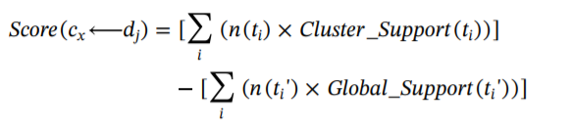
FIHC Method
In FIHC, the documents are called transactions and the features of a document are called items.
FIHC selects features (items) with a document frequency greater than the prespecified minimum (gf) threshold and uses the identified frequent features (items) as cluster centroid.
A document dj is initially assigned a set of candidate clusters, on the basis of its own frequent items.

Slide 13
TAFIED Method
TAFIED creates clusters in which documents are temporally adjacent and share features that frequently appear in a stream of news articles.
The overall processing of this method consists of document preprocessing, cluster initialization, cluster distinction, and cluster adjustment.

Slide 14
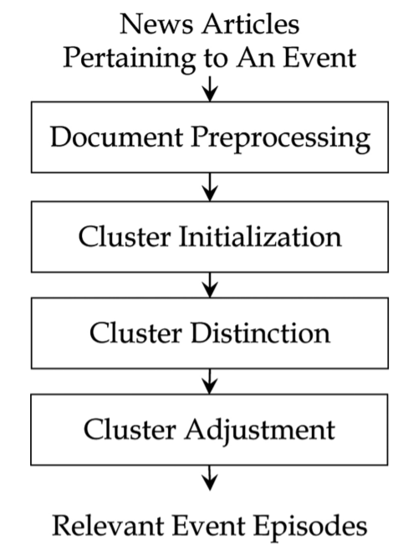
TAFIED Method contd
Proposed TAFIED Model for our problem statement

Slide 15
TAFIED Method contd
In document preprocessing, TAFIED extracts meaningful terms like nouns, noun phrases, and verbs from each news article, applies a rule based part-of-speech tagger to tag each word in the article.
Stop words such as non semantic-bearing words get removed, and the remaining words are stemmed into their respective original forms.

Slide 16
TAFIED Method contd
In cluster initialization, TAFIED constructs a set of initial clusters and assigns each news article to candidate clusters according to its own frequent items.
Term ti is a frequent item if the ratio between its document frequency (number of news articles with term ti) and the total number of news articles exceeds the prespecified minimum global support gt.
By viewing each frequent item as a class label, our method can create a set of initial clusters.

Slide 17
TAFIED Method contd
After cluster initialization, each news document has been assigned to at least one candidate cluster. Each news article pertains to one and only one event episode so cluster distinction has to done.
During this process, TAFIED assesses the fit between a document and each candidate cluster, selects the most appropriate cluster, and generates a final set of clusters. A fitness function is needed for this purpose.

Slide 18
TAFIED Method contd

Slide 19
TAFIED Method contd
In cluster adjustment, TAFIED merges the clusters that contain highly similar or relevant documents.
A combined cohesion measure evaluates the appropriateness of merging two clusters.

Slide 20
Which is better suited for our requirement?
Event episode discovery should properly consider two issues: news articles describing different episodes of a particular event have similar content, and different episodes could emerge concurrently within a time window.
TAFIED satisfies both the above requirements as it basically extends FHIC by incorporating temporal locality, according to the fit between a cluster and a document.

Slide 21
Review 2-Implementation

Slide 22
Dataset used
We generated our own dataset from NewsApi.
The dataset contains articles representing all the major events published in India from 27-03-2021 to 20-04-2021.

Slide 23
Dataset description
The dataset has 9900 news articles.
The attributes of the dataset are source, author, title, description ,url , urltoImage, PublieshedAt, description.
Preprocessing of this dataset has been done before running the algorithm.

Slide 24
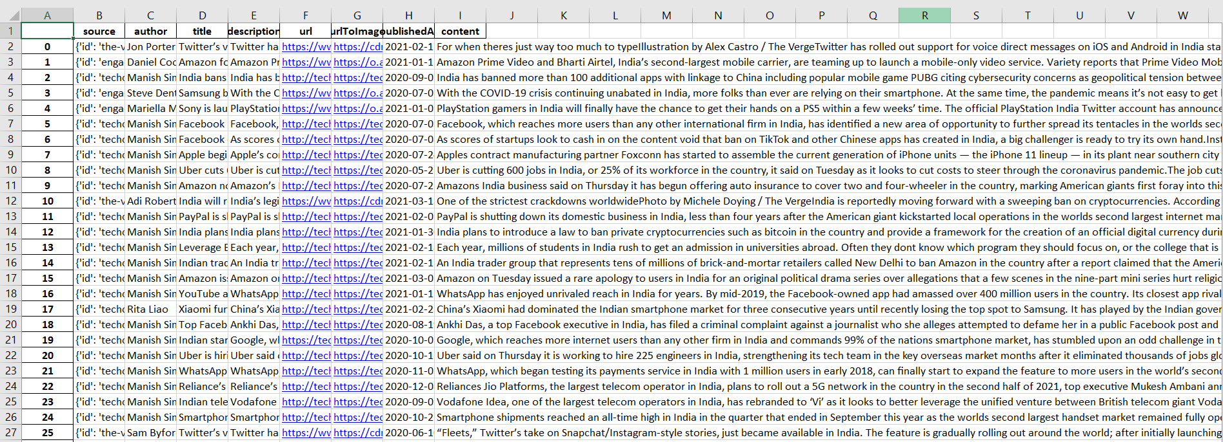
Dataset used

Slide 25
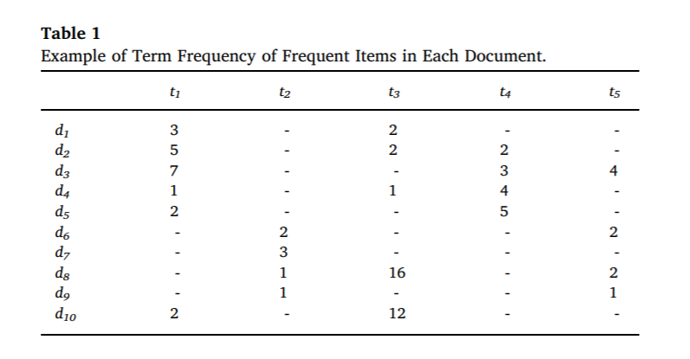
Numerical Analysis

Slide 26
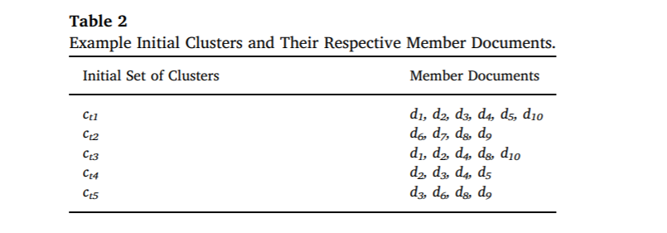

Slide 27
Formula
where T is a set of frequent items,
ti denotes a frequent item,
CS(ti, cx) is the cluster support,
TFIDF(ti, dj) represents the within-document term frequency f,
TP(cx) is a temporal proximity (TP) function,

Slide 28
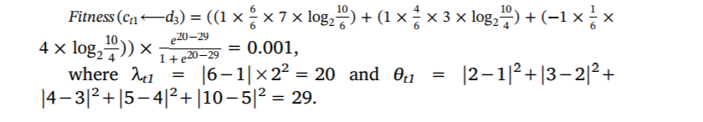

Slide 29
Performance Measures
The cluster recall (CR) and cluster precision (CP) of the target event are the two major performance measures.
CR=|CA| / |TA | and CP = |CA | / |GA |, where TA refers to the set of associations of documents in the true event episodes, GA denotes the set of associations of documents in the event episodes generated by a technique under evaluation, and CA is the set of associations of documents that exists in both the true and generated event episodes.

Slide 30
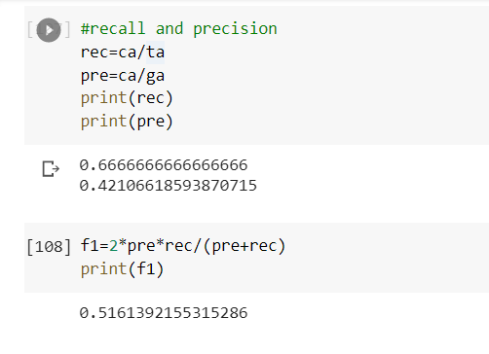
Results of our implementation(TAFIED)

Slide 31
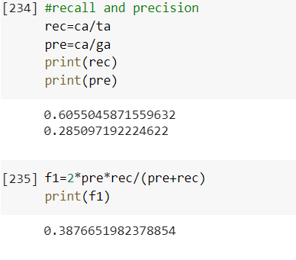
Results of our implementation(FIHC)

Slide 32
Results comparison
 | Cluster Recall | Cluster Precision | F-measure
TAFIED | 0.667 | 0.421 | 0.516
FIHC | 0.606 | 0.285 | 0.388

Slide 33
Improvements Done
Due to the unavailability of the dataset given in the paper we created our own dataset using an Api. This enabled the dataset to become much more tailor made for our requirement as we could create it based on the events we specified.
All the functions used in TAFIED method were implemented in python without using libraries.
HAC implementation for the same dataset has also been done.

Slide 34
Future Scope
Using API’s, web scraping the TAFIED algorithm can be run in real time making the process of maintaining the episodes of a event less cumbersome.
The fitness function used in cluster distinction step has 4 more sub functions which are mathematically complex and take a lot of computational time. Thus this method may fail if the dataset is too large.
A common efficient implementation of the algorithm which can overcome it’s current drawbacks.

Slide 35
Work distribution
FIHC code- Mayur Bhat.
TAFIED code-Sukruth N Bhat.
HAC code and presentation- Both of us.

